Slide 1

Youth Trends Analysis
Understanding the Preferences, Behaviors, and Mindset of Today’s Youth

Slide 2


Introduction
Youth are the driving force of any nation's future.
This project explores the current trends, preferences, behaviors, and challenges that today’s youth face.
The aim is to understand what shapes the mindset of Gen Z in areas such as social media, career choices, technology use, lifestyle, and mental well-being.
The insights can help educators, marketers, and policymakers connect better with the youth population.

Slide 3
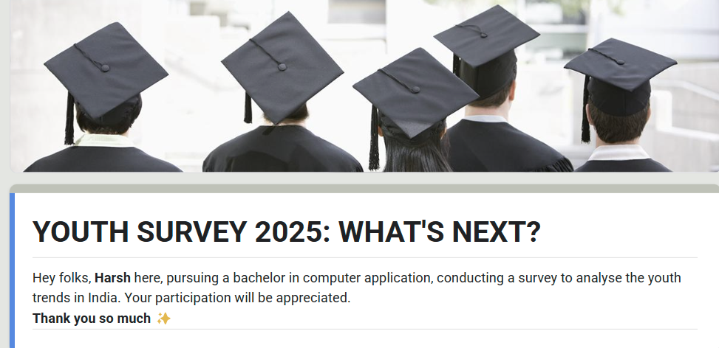
Data Collection
Primary data was collected through a 🌐 Google Form survey targeting Indian youth aged 18–26.
The form consisted of close-ended questions focusing on social media habits, career goals, lifestyle choices, and mental health awareness.
Received responses from 120+ participants across multiple states.
Data was cleaned and analyzed using Python (Pandas, Matplotlib) and visualized using Power BI 📊.
Secondary research sources included articles, youth trend reports, and social media analytics.

Slide 4

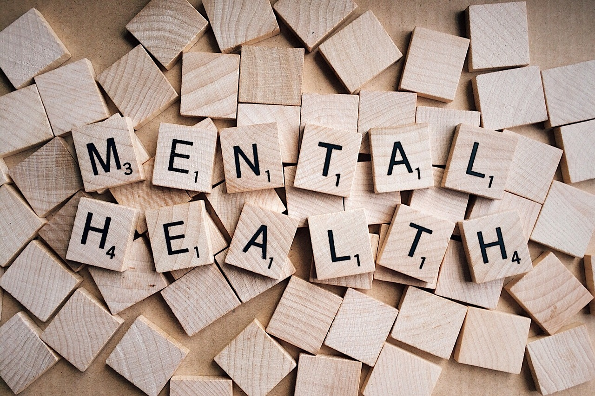


Key Areas of Analysis
Social Media Usage – Platforms, screen time, content preferences
Mental Health Awareness – Openness, coping methods, digital burnout
Relationship Preferences- Youth’s preference towards marriage
Financial Importance- Youth Mindset about Financial Freedom
And Investment

Slide 5
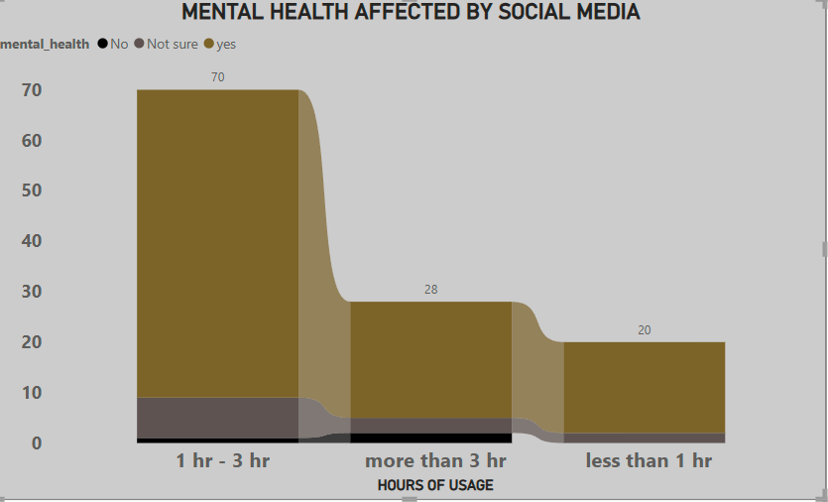
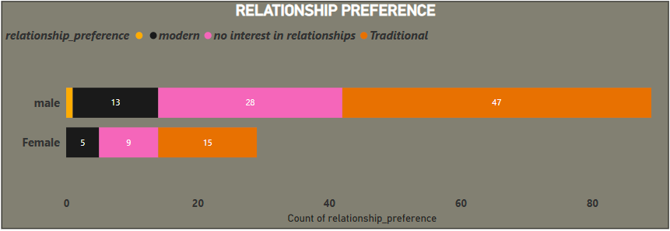
Key Insights from Youth Trends Data
Mental Health Affected by Social Media
Respondents who are more active on Social media
reported that their mental Health is not OK
Relationship Preferences
A brave step towards knowing the Youth’s
preferences for their relationships

Slide 6
In-Depth Trend Analysis
Trend 1: Increased Mental Health Openness
Observation: Over 99% of respondents are comfortable talking about mental health.
Why? Rising awareness via social media, influencers, and Gen Z’s openness.
What it implies: Mental health services and communication strategies should target digital platforms.
Trend 2 : Relationship Preferences
Dominant Preference: Traditional relationships are the most popular (53%), favored similarly by males (53.41%) and females (51.72%).
Significant Disinterest: About 32% (31.62%) of people are uninterested in relationships, with no notable gender difference.
Niche Modern Preference: Modern relationships are least common (15.38%), with females slightly more inclined (17.24% vs. 14.77% for males).
Gender Similarity: Preferences are largely similar across genders, with minor differences (females slightly more modern-leaning, males slightly more traditional-leaning).

Slide 7
✍️ Conclusion & Recommendations
🎓 Educational Institutions should offer flexible career guidance supporting unconventional paths
Mental Health Campaigns must go digital 📱 and be youth-friendly.
Brands and Marketers should focus on authentic, relatable content.
Policy Makers can use such insights 📊 to draft youth-centric policies and initiatives.
Youth today are digitally driven, open-minded, and career-fluid.
There is a strong shift toward freelancing, mental health awareness, and tech-savvy lifestyles.
Their choices are heavily influenced by social media and peer culture.
.

Slide 8
Thank you 🤝
“Looking forward to your questions and feedback.”

